Slide 1
Software Correctness Tools
Mark Gritter
Minnebar 2019

Slide 2


About Me
Twitter: @markgritter
Github: mgritter
ex-Tintri (co-founder and lead architect)
Vault Advisor at Hashicorp
This talk does not reflect the opinions of my current or former employers.

Slide 3

Software sucks
Software is hard.
“Try very hard and think a lot” is a failed solution.
Even very smart people miss simple edge cases.
Notes:
Smart people still produce bugs. It’s inevitable. Even when they try to prove that their code is correct, seasoned professionals make mistakes.

Slide 4
What do Software correctness tools do?
Static analysis
Dynamic analysis
Analyze the structure
Measure the behavior
Find novel inputs
Linter
Memory checker
Test case generator
Proof assistant
Virtual machine
Model checker
Type checking
Visualization
Symbolic execution
Fuzzer
Notes:
Tools for software correctness can be characterized by what they’re trying to accomplish:
Analyze the structure of your code and look for anti-patterns or inconsistencies.
Measure the behavior of your code and see what it actually does, by instrumenting it or placing it in a controlled environment.
Find novel inputs that induce failures (or at least new behaviors) in your code.

Slide 5
Software Correctness Tools and devops
Analyze the structure
Measure the behavior
Find novel inputs
Code review
Monitoring / observability
Test plans
Benchmarks
Chaos Engineering
Coverage metrics
Notes:
But these aren’t new, they are part of the normal software development practice. We have code reviews that look at the code itself, various sorts of benchmarks and monitoring for measuring how it behaves, and test plans that try to get the code to fail.

Slide 6
Strengths and weaknesses
A software correctness tool has value because it has a different set of biases than human programmers and testers.
Methodical, but dumb.
Humans come in with an understanding of how code is “supposed to work”; tools do not.
Humans are great at experimenting and exploring… for about 20 tests, then they get bored.

Slide 7
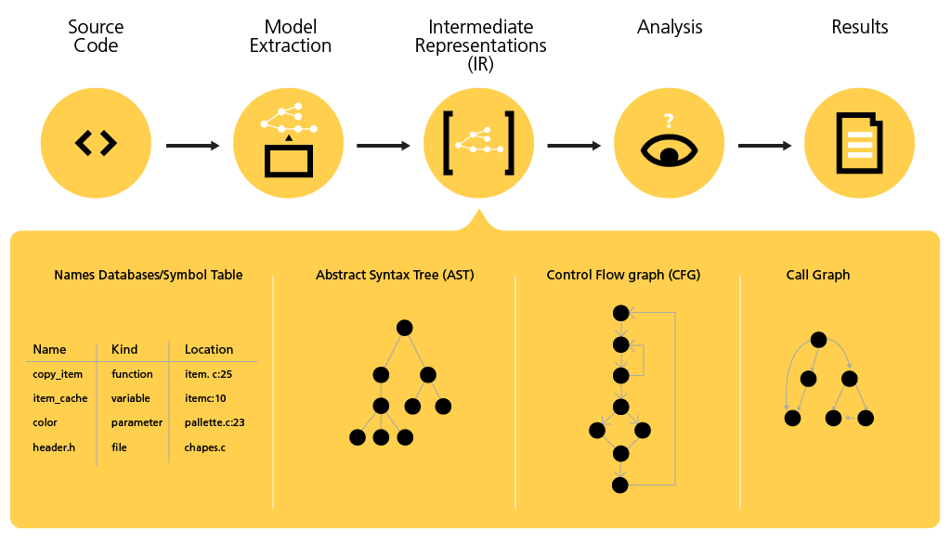
Static Analysis
Tons of open source and commercial tools:
C and C++: Coverity, cpplint
C# and .NET: StyleCop, Parasoft
Java: FindBugs/SpotBugs,
JS: JSLint/JSHint
Python: Pylint, PyCharm
As a service: SonarQube, Veracode

Slide 8
Static analysis example
Is this memory stored or freed on every exit from the function?
char *a = new char[40];

Slide 9
Static analysis downsides
If you haven’t been using one from day 1, you usually have an immense backlog.
Little support for honing in on which patterns are meaningful errors.
Does it work with your compiler?
Developers argue with the tools: “that’s not really a bug.”

Slide 10

Fuzzers
Send random data to a program and see what happens!
(You don’t need a tool to do this, you can do it as part of unit or integration testing.)

Slide 11

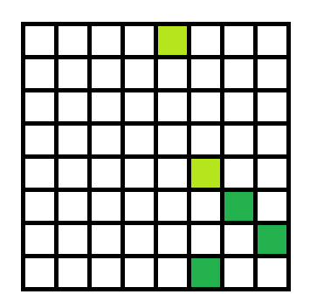
Advanced fuzzing
Instrument the code (compile-time or run-time) to check code (or data!) coverage from inputs.
Prioritize variations of inputs that lead to new patterns of execution.
Input A
Input B

Slide 12
Example fuzzers
AFL (American Fuzzy Lop): demonstrated the power of coverage-based fuzzing
libFuzzer: included as part of clang/LLVM
go-fuzz
Syzcaller: Linux kernel syscall fuzzing, run continuously
All of these have mountains of bugs and CVE’s to their credit.
If you’ve never run a fuzzer against a parser, it’s likely it will find bugs
I did this both at Tintri and as a side project

Slide 13
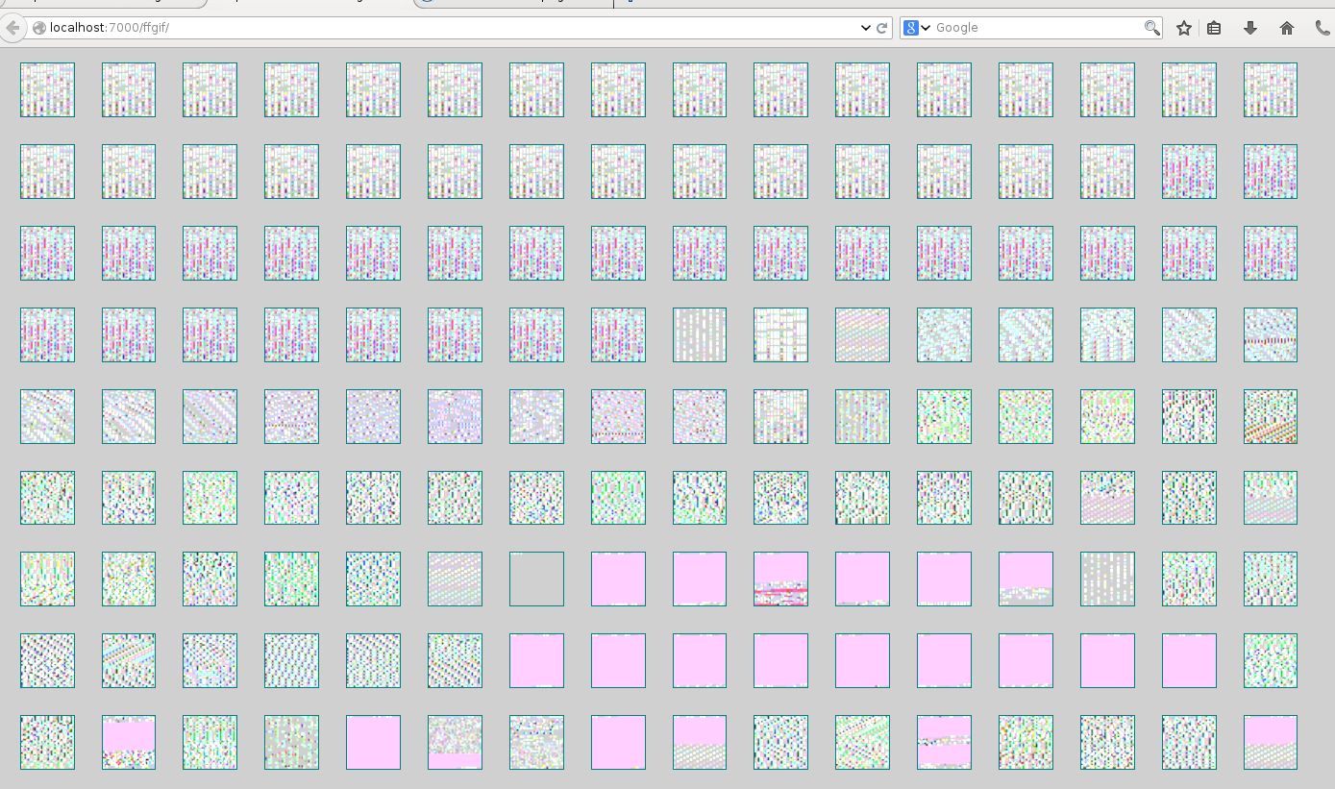
An example bug
Firefox leaked uninitialized memory when asked to display malformed GIFs.
https://bugzilla.mozilla.org/show_bug.cgi?id=1045977
CVE-2014-1564
In this case, fuzzing combined with memory checking showed the error.

Slide 14
Fuzzing downsides
Really good for finding crashes and vulnerabilities in parsers, less good for checking program logic or memory leaks.
Generally need to either already take input from standard input, or write a harness.
If you wrote a randomized test, consider taking its input from a fuzzer instead.
Sometimes requires program tweaks to work well, for example disabling checkums. Dictionary-based approaches can help with special keywords, or specialized input generators like ProtoFuzz

Slide 15
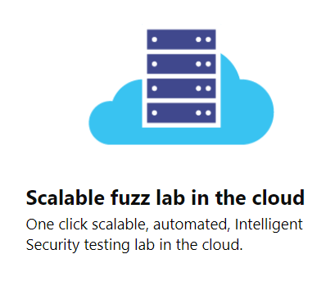
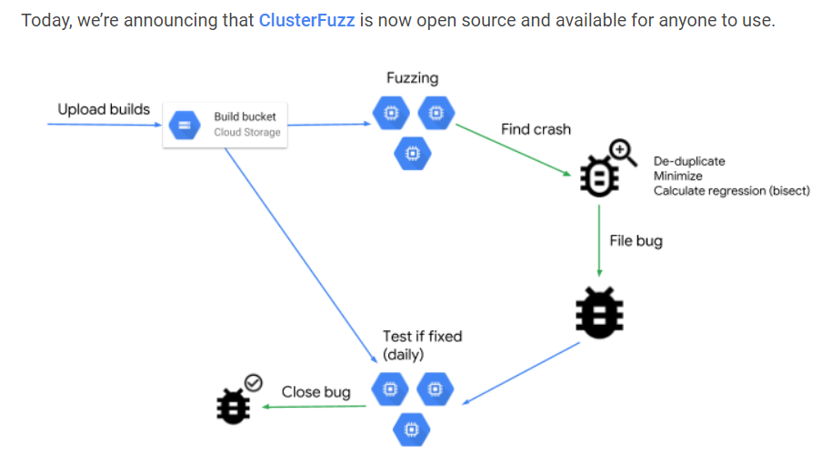

Fuzzing as-a-service
Microsoft Security Risk Detection
Google OSS-Fuzz (and ClusterFuzz)
https://github.com/google/oss-fuzz

Slide 16

Symbolic execution
Replace inputs with unbound variables, and use algebra and logic.

Slide 17
Symbolic execution example
X = anything
Y = X+3
y = x + 3
If ( y < 20 ) { … }
Y = X+3 < 20
X < 17
Z = foo[X]
Y = X + 3 >= 20
X >= 17
Z = 0
z = 0
z = foo[x]
z -= 1
Y = X+3 < 20
X < 17
Z = foo[X] - 1
Y = X + 3 >= 20
X >= 17
Z = -1
OR

Slide 18
Symbolic execution systems
KLEE (LLVM), KeY (Java), Otter (C), SymJS (Javascript), Mayhem (commercial from ForAllSecure, various)
Often based on SMT (Satisfiability Modulo Theory) provers
Boolean satisfiability along with integer arithmetic mod 2^N
Examples: Z3, STP, Yices
Computationally expensive, but getting better.

Slide 19

Virtual Machines
Augment the “usual” memory model with additional state.
Usually slower, but can run real programs and find memory errors and race conditions.

Slide 20
Memory checking
Popular examples: Valgrind, MemorySanitizer
Methods:
White-box: Rewrite every read and write to bounds-check
Black-box: Use operating system memory protection to put guards around allocated memory
Black-box: Keep backtrace of each memory allocation, show which locations allocate leaked memory.
Memory
Page marked to disallow access

Slide 21
Concurrency checkers
ThreadSantizer, used in Go race detector, Parallocity ZVM (defunct)
When memory is read or written:
Record which thread, and which locks were held
If subsequent accesses from a different thread don’t use a lock, it’s a race condition.
T1
write
T2
Mem
read
write

Slide 22
Data tainting
A recent example from Google Project Zero: “Detecting Kernel Memory Disclosure with x86 Emulation and Taint Tracking”
Run the kernel in Bochs
Track “taint” on new stack, heap, or pool allocations
Propagate the taint to copies
Erase taint when memory is overwritten with constant values
Found 65 CVEs in Windows!

Slide 23
Runtime checking pro/con
Can usually be run on even the most complicated software, but very memory-hungry. Research in this area is usually about how to use less memory.
Some amount of false positives, particularly in concurrency checking. Nonstandard usage can’t be checked like application-specific memory allocation or locking.
Probably need to combine with another technique to get good coverage, but very useful if you already know the general area to look.

Slide 24

Model checkers
Explore whether an invariant holds on a given description of the software.

Slide 25

TLA+
Written by Leslie Lamport, “Temporal Logic of Actions”
Describes the logical relationship between steps of the computation (or other process!) using the language of set theory.
A:0
B:0
A:1
B:0
A:2
B:1
A:2
B:2
TLC model checker enumerates all possible “behaviors” obeying this specification and checks invariants, or deadlock.
Used by Amazon to find bugs in AWS. I reproduced a simple concurrency bug from work. Good for concurrent systems.
Hillel Wayne (@hillelogram) has a book out this year “Practical TLA+”

Slide 26
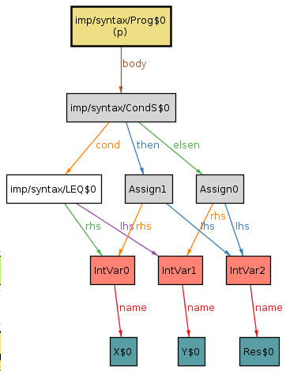
Alloy
Relational model that uses a SAT solver to check invariants, or prove an example exists.
Good integration with graphing tool to show examples; easier to get started than TLA+, but somewhat more difficult to represent concurrency. Great for data structures.
Pamela Zave used Alloy to find bugs in the distributed hash table Chord.
// Move x to directory d
pred move [fs, fs': FileSystem, x: FSObject, d: Dir] {
(x + d) in fs.live
fs'.parent = fs.parent - x->(x.(fs.parent)) + x->d
}

Slide 27
Model checking limitations
You can’t tell how well your design actually represents the code that got written; are you updating it as the code changes?
Exhaustive testing of models is expensive; a lot of the “folk knowledge” is how to represent a system in a feasible way.
But, this is great for finding a different class of bugs than techniques that only work on code.
Other model checkers: SPIN/Promela, BLAST, PRISM

Slide 28

Proof assistants
Verify that the stated properties of a program hold, using hints from the programmer.
Programmer will often have to write a loop invariant or other property that can then be proved or checked.
Interactive process: tool will try to indicate where it got lost.
A lot of overlap with purely mathematical theorems; many tools can be used for both.
Examples: Isabelle, CoQ

Slide 29
KEY
KeY (key-project.org) incorporates a lot of the ideas:
Annotate Java program in a modelling language
Prove the assertions specified in the modelling language
Rule-based symbolic execution
SMT solver
Works with real Java code; unfortunately, no floating point or Generics or Java 8 features.

Slide 30
Key’s most famous bug, timsort
/*@ private normal_behavior
@ requires
@ n >= MIN_MERGE;
@ ensures
@ \result >= MIN_MERGE/2;
@*/
private static int /*@ pure @*/ minRunLength(int n) {
assert n >= 0;
int r = 0; // Becomes 1 if any 1 bits are shifted off
/*@ loop_invariant n >= MIN_MERGE/2 && r >=0 && r<=1;
@ decreases n;
@ assignable \nothing;
@*/
while (n >= MIN_MERGE) {
r |= (n & 1);
n >>= 1;
}
return n + r;
}
see my Minnebar 2015 talk,
“Never Trust Any Published Algorithm”
https://www.youtube.com/watch?v=S2uEUghfiXY

Slide 31

Property-based testing
Generate inputs from a schema and validate the results (using an alternate implementation, or an assertion.)
“For all x, if P(x) holds, does Q(x) hold?”
Examples:
QuickCheck (Haskell)
fast-check (Javascript)
Hypothesis (Python)
RapidCheck (C++)

Slide 32
Hypothesis example
from hypothesis import given
from hypothesis.strategies import text
@given(text())
def test_decode_inverts_encode(s):
assert decode(encode(s)) == s

Slide 33
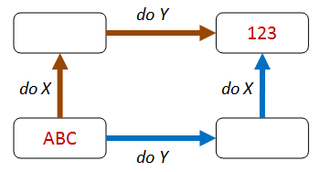
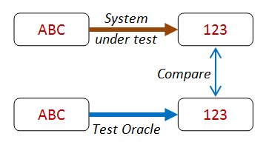
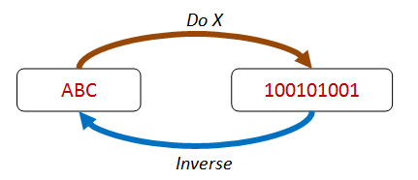

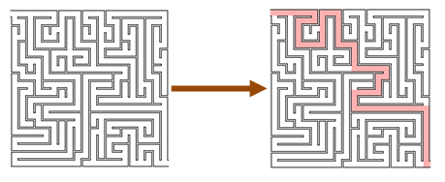

Ways to property test
commutative
oracle
inverse operation
idempotent
verification
invariant
Examples from: https://fsharpforfunandprofit.com/posts/property-based-testing-2/

Slide 34
Property testing pro/con
If you are writing unit tests, this is almost a freebie. Writing meaningful test case generation can be a little challenging.
But if you’re writing randomized tests already, consider using a property-based framework to get test case minimization
Runs quickly, but coverage can be hit-or-miss; most property-based testers don’t yet take advantage of coverage information.

Slide 35
Test generation
Test case generation: Given a model or an implementation, generate test cases
Edge case generation: Heuristically pick inputs that are likely to trigger edge cases.
Test case minimization: Find test inputs that cover the space of behaviors, or are the smallest example of a particular behavior.
Examples: Randoop, Hypothesis, Tcases, AgitarOne, Jtest, Evosuite, UniqueSoft D*Code, Conformiq
Often commercial tools are aimed at generating regression tests for a legacy piece of software.

Slide 36

Not covered in this talk
Visualization tools
Observability tools
Load generators
Mocking frameworks
UML

Slide 37
Do bugs matter? Lessons from Coverity
Companies buy bug-finding tools because they see bugs as bad. However, not everyone agrees that bugs matter. The following event has occurred during numerous trials. The tool finds a clear, ugly error (memory corruption or use-after-free) in important code, and the interaction with the customer goes like thus:
"So?"
"Isn't that bad? What happens if you hit it?"
"Oh, it'll crash. We'll get a call." [Shrug.]
If developers don't feel pain, they often don't care. Indifference can arise from lack of accountability; if QA cannot reproduce a bug, then there is no blame.
-- Bessey et al, “A Few Billion Lines of Code Later”,
Communications of the ACM, February 2010

Slide 38
challenge
Think about what tools you could add to augment the things you’re already doing!
Design reviews: TLA+, Alloy
Code reviews: Static checker
Unit testing: Hypothesis, libFuzzer
Integration testing: valgrind, MemorySanitizer, Go Race Detector
Security audits: all of the above + ???
All of these are easy to get started with; pick just one small thing to get started and demonstrate the value. You can also use them on bugs you already know about to figure out how you could have found them.

Slide 39

Thank you!
Twitter: @markgritter
Email: mgritter@gmail.com
Github (w/ slides): mgritter
Side project: @fuzz-ai
(on hiatus)
Images by Denis Azarenko from Pixabay

